Slide 1


SOEN 6431 Software Maintenance and Program Comprehension
Week 6:
Basics - Software Testing

Slide 2
Terminology
Failure: misbehavior of the system
Fault: An error in the system that eventually causes a failure, also know as a “bug”
Fault identification: the process of discovering what fault caused a failure
Fault correction: the process of ensuring that a failure does not happen again

Slide 3
Software Failure
A requirement was omitted
Requirements were not implementable
Specification was incorrect
Error in the high-level design (architecture)
Error in the low-level design
Error in the code

Slide 4
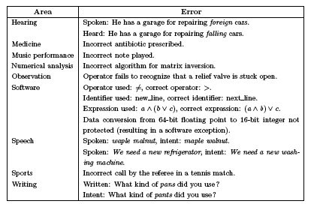
Errors Are a Part of Our Daily Life
Aditya P. Mathur. Foundations of Software Testing

Slide 5
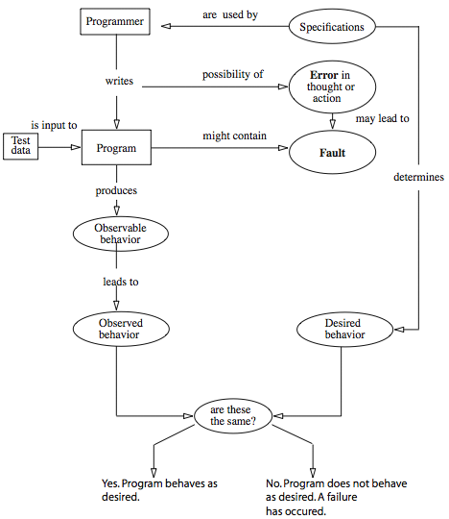



Errors, Faults, and Failures

Slide 6


Software Defects and Errors
Variety of terminology
Bug, Error, Defect, Fault, Flaw
‘Fault’ implies someone is to blame
Defect- variance from a desired product attribute.
Defect from product specification (wrong)
Example: the spec may say that a is to be added to b to produce c. If the product does not do so, it is considered to be defective.
Variance from customer expectation (missing or extra)
User wanted, not in the product, not specified to be included in the product.

Slide 7
Software Testing
Video

Slide 8
Why Does Software Have Defects?
Miscommunication or No Communication
As to specifics of what an application should or shouldn't do
Programming Errors
Programmers, like anyone else, can make mistakes.
Changing Requirements
Whether documented or undocumented
Time Pressures
Scheduling of software projects is difficult at best, often requiring a lot of guesswork.
Egos - people prefer to say things like:
'no problem‘, 'piece of cake‘,
'I can whip that out in a few hours‘,
'it should be easy to update that old code'
From http://www.softwareqatest.com/qatfaq1.html

Slide 9
Categories of Common Software Errors
User Interface Errors
Functionality problem
Something that a user expects the program to do is hard, awkward, confusing, or impossible
Communication
how do you find out how to use the program?
What info is readily available onscreen? Is there enough? Is it intelligible? Is it insulting?
What are you told when you make a mistake? Is anything irritating, misleading, or poorly presented?
Missing commands
Command structure
Is it easy to get lost in the program?
Are there any commands confusing or easy to confuse with others?
Performance
Anything that makes the user feel that the program is working slowly is a problem
Output
Are you getting what you want? Do the printouts make sense?
Will the program save data in a format that another program can read, …
From Kaner, Falk and Nguyen, Testing Computer Software

Slide 10
Categories of Software Errors - cont
Error Handling Errors
Failure to anticipate the possibility of errors and protect against them,
Failure to notice error conditions,
Failure to handle a detected error in a reasonable way.
Most programs correctly detect errors but then branch into untested error recovery routines
Boundary-Related Errors
If program’s use and functioning can be described as running in ranges of values, the program may croak outside the boundaries.
Control Flow Errors
When the program does the wrong thing next

Slide 11
Categories of Software Errors - cont
Initial and Later States
E.g. failure to initialize a loop control variable, or clear a flag
Errors in Handling or Interpreting Data
E.g. data might be corrupted or misinterpreted when from module to module.
Calculation Errors
Misinterpret complicated formulas, lose precision due to rounding and truncation errors
Computational errors due to incorrect algorithms

Slide 12
Categories of Software Errors - cont
Race Conditions Between Events
E.g. Programmer did not realize that B could win the race, but B will come first only under special conditions
Hard to replicate.
Lead to many reports of ‘irreproducible’ bugs.
Hardware
Send bad data to device, try to use devices that are busy or aren’t there, …

Slide 13
Categories of Software Errors - cont
Load conditions – misbehave when overloaded
Program may fail under
a high volume (much work over a long period) or
a high stress (maximum load at one time)
runs out of memory and other resources, tries to share memory or CPU time with other programs
Issues are whether the program can meet its stated limits and how horribly it dies when the limits are exceeded
Source and Version Control
Old programs reappear if the programmer links an old version of one subroutine with the latest version of the rest of the program

Slide 14
Why Are Defects Hard to Find?
Some reasons defects go undetected
Not looking
Tests often are not performed because a particular test condition was unknown;
Some parts go untested because developers assume changes do not affect them
Looking, but not seeing
developers become so familiar with their system that they overlook details
This is why used to provide independent v&v is a fresh viewpoint
From Mosley and Posey. Just Enough Software Test Automation

Slide 15

Why Are Defects Hard to Find? - cont
Defects arise from various circumstances
Developers improperly interpret requirements
Users specify the wrong requirements
The requirements are incorrectly recorded
The design specifications are incorrect
There are errors in program coding
There are data entry errors
There are testing errors
There are mistakes in error correction
The corrected condition causes another defect

Slide 16
Defect Rate and Development Process
60% of all defects in the requirements phase are due to missing requirements.
For immature process, 6 defects/1000LOC not unusual.
Leading commercial software developers - one defect per 1000-30,000 LOC
Windows XP: 40M LOC (2001)
Windows Vista Beta 2: 50M LOC (2005)
The study helps define defect expectations
Any time a process is used, defects of approximately the same type and frequency will occur

Slide 17
Quality Assurance vs Testing
Quality Assurance - Preventing Bugs
The earlier in the process a bug is discovered and corrected, the cheaper the correction.
Testing Isn’t Everything
Non-testing Activities
Prototyping – incomplete implementation that mimics the behavior we think the users need.
Requirement analysis – checking the requirements for consistency, testability and feasibility. Cannot expect users to provide valid req. who are not trained to do so.
Formal analysis, possibly mathematical
Design – ill-considered design may destroy the best req.
Formal inspection – a process without formal inspection is seriously flawed and depends too much on testing.

Slide 18
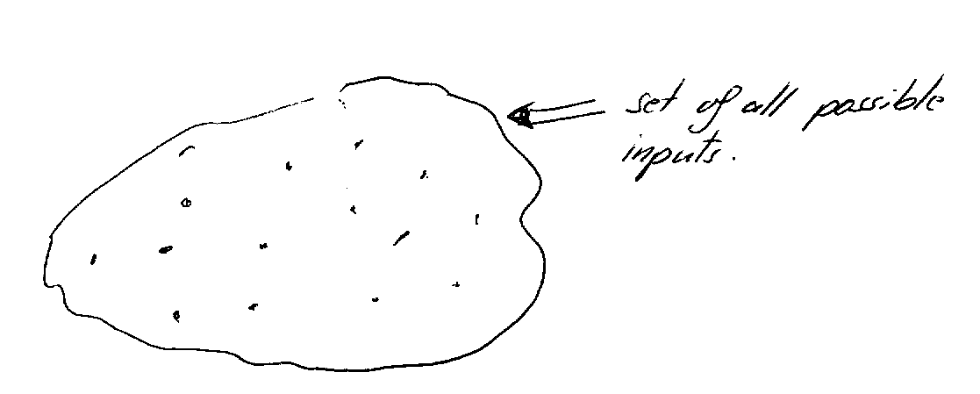
Set of If we start testing the program for different input what can we really say?
Can we show that a program is correct?
=> No, only can show that the program works for the specific inputs we tested the program.
If we test it only on one input => program is correct for that input
If we test it for 10000 different input: The program is correct for the 10.000 input.
However possible inputs might be close too infinity …..

Slide 19
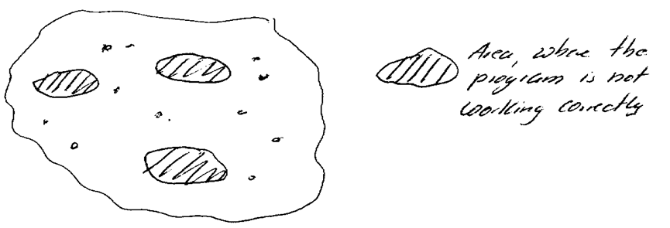
Assume that that the goal is to show that the program works correctly.
Example: You are giving a demo – for which program inputs are you going to show that the program is working correctly – for the ones you know, you tested.
You will avoid the ones which are not working or the ones you have not tested
What is now the final goal of testing?
To have confidence in the software. How can we increase our confidence in the software?
Through each successful test case our confidence for the software is growing.

Slide 20
Before we continue: Some more testing terminology

Slide 21
Two approaches
Proving that the code contains no fault.
Implies a formal definition of all the components of the software, and building a formal proof that the system is failure-proof.
Not used much, though considerable research has been and is still done in this area.
UK requires certification for certain critical applications
Perform tests designed to find faults
“testing can reveal only the presence of faults, not their absence” (Dijkstra)
Different techniques can be used to help develop appropriate test sets.

Slide 22
Static and dynamic testing
Static testing
Concerned with analysis of the static system representation (program & documentation) to discover problems
Dynamic testing
Concerned with exercising and observing product behavior

Slide 23
Static testing
Involves analysis of source text by humans or software
Can be carried out on ANY documents produced as part of the software process
Discovers errors early in the software process
Usually more cost-effective than testing for defect detection at the unit and module level
Allows defect detection to be combined with other quality checks
Note:
More than 60% of program errors can be detected by informal program inspections
More than 90% of program errors may be detectable using more formal program verification

Slide 24
Dynamic testing
The objective of dynamic testing is to discover defects in running systems
A successful defect test is a test which causes a program to behave in an anomalous way
Such tests show the presence not the absence of defects
Only validation technique for non-functional requirements
Should be used in conjunction with static testing

Slide 25
The dynamic testing process

Slide 26
Exhaustive Testing
loop < 20 X
14
There are 10 possible paths! If we execute one
test per millisecond, it would take 3,170 years to
test this program!!

Slide 27
Selective Testing
Selected path
loop < 20 X

Slide 28
Test-First Programming
Modern practices emphasize the importance of testing during development
Example: test-first programming
Basic idea: before you start writing any code, first write the tests for this code
Write a little test code, write the corresponding unit code, make sure it passes the tests, and then repeat
What programming methodology uses this approach?
What are the advantages of test-first programming?

Slide 29
Advantages of Test-First Programming
Developers do not “skip” unit testing
Satisfying for the programmer: feeling of accomplishment when the tests pass
Helps clarify interface and behavior before programming
To write tests for something, first you need to understand it well!
Software evolution
After changing existing code, rerun the tests to gain confidence (regression testing)

Slide 30
Black Box Testing
Testing software against a specification of its external behavior without knowledge of internal implementation details
Can be applied to software “units” (e.g., classes) or to entire programs
External behavior is defined in API docs, Functional specs, Requirements specs, etc.
Because black box testing purposely disregards the program's control structure, attention is focused primarily on the information domain (i.e., data that goes in, data that comes out)
The Goal: Derive sets of input conditions (test cases) that fully exercise the external functionality

Slide 31
The Information Domain: inputs and outputs
Inputs
Individual input values
Try many different values for each individual input
Combinations of inputs
Individual inputs are not independent from each other
Programs process multiple input values together, not just one at a time
Try many different combinations of inputs in order to achieve good coverage of the input domain
Ordering and Timing of inputs
In addition to the particular combination of input values chosen, the ordering and timing of the inputs can also make a difference

Slide 32
The Information Domain: inputs and outputs
Defining the input domain
Boolean value
T or F
Numeric value in a particular range
99 <= N <= 99
Integer, Floating point
One of a fixed set of enumerated values
{Jan, Feb, Mar, …}
{Visa, MasterCard, Discover, …}
Formatted strings
Phone numbers
File names
URLs
Credit card numbers
Regular expressions

Slide 33
Equivalence Partitioning
Typically the universe of all possible test cases is so large that you cannot try them all
You have to select a relatively small number of test cases to actually run
Which test cases should you choose?
Equivalence partitioning helps answer this question

Slide 34
Equaivalence partition testing
The basic idea is: Divide the input domain in sub-domains.
Assumption: All inputs in a sub-domain have common properties.
How can we identify such subdomains? Based in input conditions in the specification
There an equivalence class might be one of the two cases:
Valid equivalence class : Input in this class satisfies the input condition
Invalid equivalence class: Input in this class violates the input condition

Slide 35
Equivalence Partitioning
First-level partitioning: Valid vs. Invalid test cases
Valid
Invalid

Slide 36
Equivalence Partitioning
Partition valid and invalid test cases into equivalence classes

Slide 37
Equivalence Partitioning
Create a test case for at least one value from each equivalence class

Slide 38
Equivalence Partitioning
When designing test cases, you may use different definitions of “equivalence”, each of which will partition the test case space differently
Example: int Add(n1, n2, n3, …)
Equivalence Definition 1: partition test cases by the number of inputs (1, 2, 3, etc.)
Equivalence Definition 2: partition test cases by the number signs they contain (positive, negative, both)
Equivalence Definition 3: partition test cases by the magnitude of operands (large numbers, small numbers, both)
Etc.

Slide 39
Equivalence Partitioning
When designing test cases, you may use different definitions of “equivalence”, each of which will partition the test case space differently
Example: string Fetch(URL)
Equivalence Definition 1: partition test cases by URL protocol (“http”, “https”, “ftp”, “file”, etc.)
Equivalence Definition 2: partition test cases by type of file being retrieved (HTML, GIF, JPEG, Plain Text, etc.)
Equivalence Definition 3: partition test cases by length of URL (very short, short, medium, long, very long, etc.)
Etc.
Test multiple values in each equivalence class. Often you’re not sure if you have defined the equivalence classes correctly or completely, and testing multiple values in each class is more thorough than relying on a single value.

Slide 40
Equivalence Partitioning - examples
Input | Valid Equivalence Classes | Invalid Equivalence Classes
A integer N such that: -99 <= N <= 99 | ? | ?
Phone Number Area code: [200, 999] Prefix: (200, 999] Suffix: Any 4 digits | ? | ?

Slide 41
Equivalence Partitioning - examples
Input | Valid Equivalence Classes | Invalid Equivalence Classes
A integer N such that: -99 <= N <= 99 | [-99, -10] [-9, -1] 0 [1, 9] [10, 99] | ?
Phone Number Area code: [200, 999] Prefix: (200, 999] Suffix: Any 4 digits | ? | ?

Slide 42
Equivalence Partitioning - examples
Input | Valid Equivalence Classes | Invalid Equivalence Classes
A integer N such that: -99 <= N <= 99 | [-99, -10] [-9, -1] 0 [1, 9] [10, 99] | < -99 > 99 Malformed numbers {12-, 1-2-3, …} Non-numeric strings {junk, 1E2, $13} Empty value
Phone Number Area code: [200, 999] Prefix: (200, 999] Suffix: Any 4 digits | ? | ?

Slide 43
Equivalence Partitioning - examples
Input | Valid Equivalence Classes | Invalid Equivalence Classes
A integer N such that: -99 <= N <= 99 | [-99, -10] [-9, -1] 0 [1, 9] [10, 99] | < -99 > 99 Malformed numbers {12-, 1-2-3, …} Non-numeric strings {junk, 1E2, $13} Empty value
Phone Number Area code: [200, 999] Prefix: (200, 999] Suffix: Any 4 digits | 555-5555 (555)555-5555 555-555-5555 200 <= Area code <= 999 200 < Prefix <= 999 | ?

Slide 44
Equivalence Partitioning - examples
Input | Valid Equivalence Classes | Invalid Equivalence Classes
A integer N such that: -99 <= N <= 99 | [-99, -10] [-9, -1] 0 [1, 9] [10, 99] | < -99 > 99 Malformed numbers {12-, 1-2-3, …} Non-numeric strings {junk, 1E2, $13} Empty value
Phone Number Area code: [200, 999] Prefix: (200, 999] Suffix: Any 4 digits | 555-5555 (555)555-5555 555-555-5555 200 <= Area code <= 999 200 < Prefix <= 999 | Invalid format 5555555, (555)(555)5555, etc. Area code < 200 or > 999 Area code with non-numeric characters Similar for Prefix and Suffix

Slide 45
Equivalence partitioning: Example
A dimension statement: Int arrayname[dI, dII]
Is used to declare the dimensions of an array of integers. Arrayname is the symbolic name of an array. The symbolic name may contain 1 to 6 characters, where the first character must be a letter. d is specifying the dimensions of the array, where the minimum #of d is 1, the maximum number of d is 6. (Maximum of 6 dimensions)
The form of d is [lb..up];
where lb = lower bound => 0..65235
ub = upper bound => 0..65235
lb <= ub
if lb is not specified then the assumption is that lb =1;

Slide 46
Equivalence partitioning: Example
Input condition | Valid equivalence class | Invalid equivalence class 1 | Invalid equivalence class 2
size of array | 1..6 (1) | 0 (2) | > 6 (3)
character of array name | Has letters (4) Has digits (5) | Has something else (6)
1st letter must be a character | True (7) | False (8)
# of dimensions | 0<x< 7 (9) | 0 (10) | > 6 (11)
upper bound range | 0..65235 (12) | < 0 (13) | > 65235 (14)
lower bound range | 0..65235 (15) | < 0 (16) | > 65235 (17)
lb <= ub | lb = ub (18) lb < ub (19) | lb > ub (20)
lb specified | yes (21) no (22)

Slide 47
Equivalence partitioning: Example
Test case # | Test Case | Covered equivalence classes
1 | int A[1..6] | (1), (4), (7), (9), (12), (15), (19), (21)
2 | int A1[1..5] | (5)
3 | int a[5..5] | (18)
4 | int a[] | (10)
5 | int abcdefg [1..5] | (3)
6 | int ab%[1..5] | (6)
7 | Int 1ab [1..5] | (8)
8 | Int [1..5] | (2)
9 | Int a[1,2,3,4,5,6,7] | (11)
10 | Int a[70000] | (14)
11 | Int a[-1] | (13), (20)
12 | Int a[-1.. 20000] | (16)
13 | Int a[70000..9000] | (17)

Slide 48
Boundary Value Analysis (BVA)
When choosing values from an equivalence class to test, use the values that are most likely to cause the program to fail
Errors tend to occur at the boundaries of equivalence classes rather than at the "center"
If (200 < areaCode && areaCode < 999) { // valid area code }
Wrong!
If (200 <= areaCode && areaCode <= 999) { // valid area code }
Testing area codes 200 and 999 would catch this error, but a center value like 770 would not
In addition to testing center values, we should also test boundary values
Right on a boundary
Very close to a boundary on either side

Slide 49
Boundary Value Analysis
Create test cases to test boundaries of equivalence classes

Slide 50
Boundary Value Analysis - examples
Input | Boundary Cases
A number N such that: -99 <= N <= 99 | ?
Phone Number Area code: [200, 999] Prefix: (200, 999] Suffix: Any 4 digits | ?

Slide 51
Boundary Value Analysis - examples
Input | Boundary Cases
A number N such that: -99 <= N <= 99 | -100, -99, -98 -10, -9 -1, 0, 1 9, 10 98, 99, 100
Phone Number Area code: [200, 999] Prefix: (200, 999] Suffix: Any 4 digits | ?

Slide 52
Boundary Value Analysis - examples
Input | Boundary Cases
A number N such that: -99 <= N <= 99 | -100, -99, -98 -10, -9 -1, 0, 1 9, 10 98, 99, 100
Phone Number Area code: [200, 999] Prefix: (200, 999] Suffix: Any 4 digits | Area code: 199, 200, 201 Area code: 998, 999, 1000 Prefix: 200, 199, 198 Prefix: 998, 999, 1000 Suffix: 3 digits, 5 digits

Slide 53
Equivalence partitioning: Example
A dimension statement: Int arrayname[dI, dII]
Is used to declare the dimensions of an array of integers. Arrayname is the symbolic name of an array. The symbolic name may contain 1 to 6 characters, where the first character must be a letter. d is specifying the dimensions of the array, where the minimum #of d is 1, the maximum number of d is 6. (Maximum of 6 dimensions)
The form of d is [lb..up];
where lb = lower bound => 0..65235
ub = upper bound => 0..65235
lb <= ub
if lb is not specified then the assumption is that lb =1;

Slide 54
BVA: Example
Test case # | Test Case | Covered equivalence classes
1 | int A[1..6] | (1), (4), (7), (9), (12), (15), (18), (21)
2 | int A1[1..5] | (5)
3 | int a[5..5] | (19)
4 | int a[] | (10)
5 | int abcdefg [1..5] | (3)
6 | int ab%[1..5] | (6)
7 | int 1ab [1..5] | (8)
8 | int [1..5] | (2)
9 | int a[1,2,3,4,5,6,7] | (11)
10 | int a[70000] | (14)
11 | int a[-1] | (13), (20)
12 | int a[-1.. 20000] | (16)
13 | int a[70000..9000] | (17)
BVA
14 | int a[1..2] | => 1 dimension, 1 character
15 | int ab[1..2,1..2] | => 2 dimensions, 2 characters
16 | int a[1,2,3,4,5,6] | => 6 dimensions
17 | int a[1,2,3,4,5] | => 5 dimensions
18 | int a[0..65235] | => borders
19 | int a[-1..65235] | => borders
20 | int a[1..65235] | => borders
21 | int a[1..65234] | => borders
22 | int a[1..65236] | => borders
23 | int a[65235..65235] | => borders
24 | int a [65234..65234] | => borders
25 | int a[65236..65236]
26 | int a [-1..-1]
27 | int a[0..0]
28 | int a[1..1]
29 | int a[2..100]
30 | int a [1..2]
31 | int a [2..1]

Slide 55
What is White Box testing
White box testing is testing where we use the info available from the code of the component to generate tests.
This info is usually used to achieve coverage in one way or another – e.g.
Code coverage
Path coverage
Decision coverage
Debugging will always be white-box testing

Slide 56
White-box testing

Slide 57
Flow graph representations

Slide 58
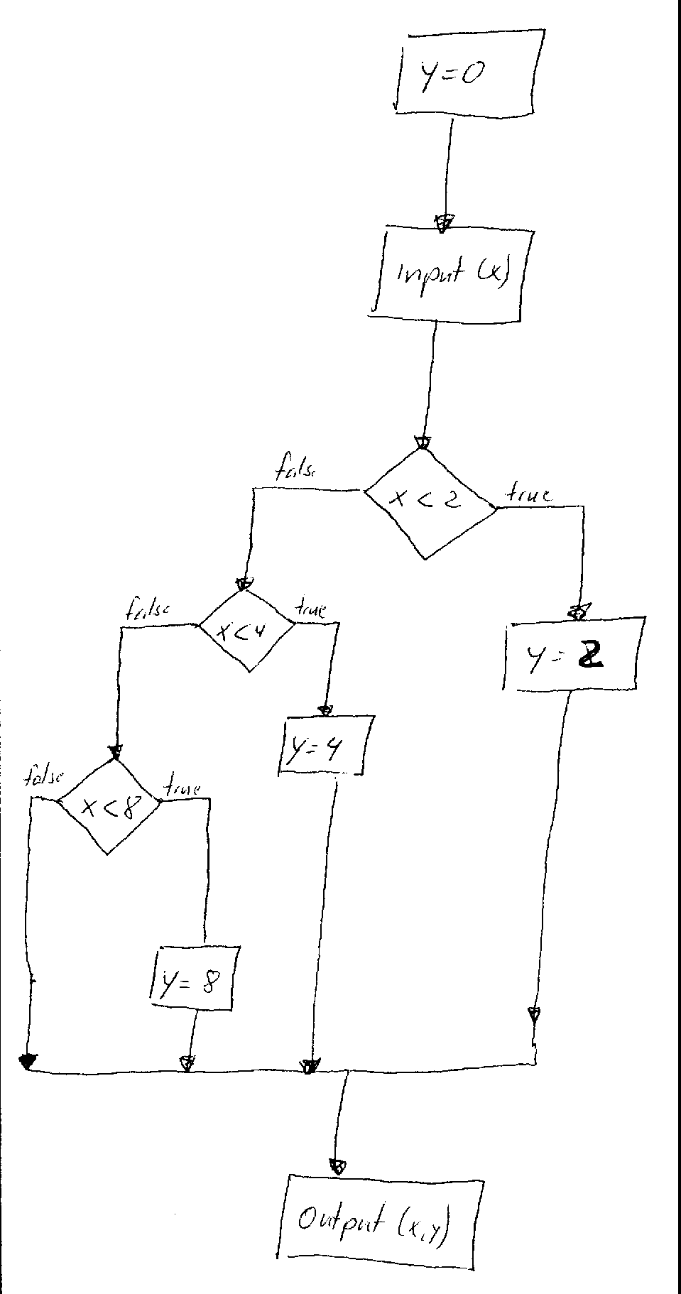
Statement testing
Every statement should be executed at least once.
Example:
Test #1 : x= 1
Test #2 : x = 3
Test #3 : x = 7
What about x = 9 ?

Slide 59
Branch testing
Every branch in the program should be executed at least once.
Using statement testing with the 3 test cases, one branch was never executed.
Test case #4 is necessary with x= 9

Slide 60
Multiple condition testing
Extension of Branch testing for the cases where we have composite conditions.
Bugs are very frequent in composite conditions
Example:
For branch testing
Test case #1: x =1; y = 0;
Test case #2 x =0; y =0;
Are we satisfied with these test case?
input (x,y)
if (x > 0 ) and (y < 2)
then y:= 5
else y:= 7;
write (y);

Slide 61
Multiple condition testing
The goal is to create test cases for all conditions
input (x,y)
if (x > 0 ) and (y < 2)
then y:= 5
else y:= 7;
write (y);
Test case | X > 0 | Y < 1
#1 | T | T | X = 5; y = 0
#2 | T | F | X = 5; Y = 1;
#3 | F | T | X = 0; Y = 0
#4 | F | F | X = 0; Y = 2

Slide 62
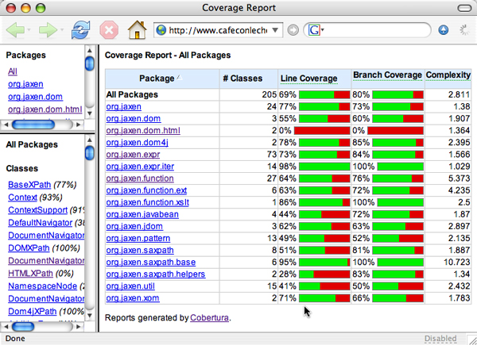
Coverage report. Example – 1

Slide 63
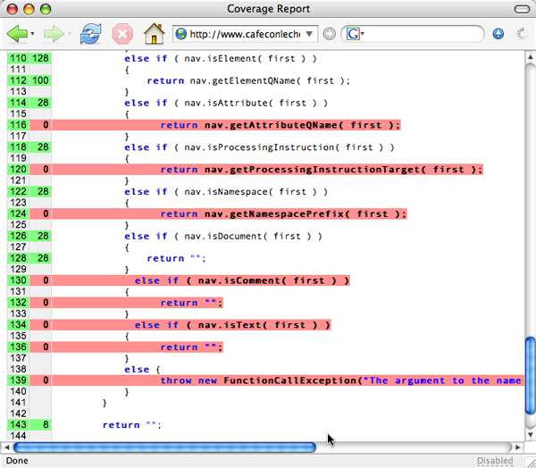
Coverage report. Example – 2

Slide 64
Path testing
Ensuring that every path in the code is executed at least once.
Number of test cases for branch testing: 2.
For path testing: 4 paths
0,1,3,4
0,1,3,5
0,2,3,4
0,2,3,5
Including a third if statement:
Branch testing: The minimum # of test cases would be still 2
Path testing: The minimum # of test cases would be 8
Problem?

Slide 65
Loop Testing
Simple
loop
Nested
Loops
Concatenated
Loops
Unstructured
Loops

Slide 66
Problems with path testing
May give the misleading impression that the program has been thoroughly tested.
Defects may arise when specific path combinations are used, even though all statements have been tested.
Apart from trivial components, it is generally impossible to test all paths.
Programs with loops may have an infinite number of paths.
Integration path testing is generally not possible.

Slide 67
Key points
Test parts of a system which are commonly used rather than those which are rarely executed
Equivalence partitions are sets of test cases where the program should behave in an equivalent way
Black-box testing can be based on the system specification
Structural testing identifies test cases which cause all paths through the program to be executed
It is not possible to exercise all path combinations for large, complex systems, especially for integration testing
Interface defects arise because of specification misreading, misunderstanding, errors or invalid timing assumptions

Slide 68
Integration Testing
Remember Continuous Integration ?

Slide 69
Integration testing strategies
Integration testing is about the incremental integration and testing of modules in the system
Integration testing strategies are ways integrating modules in different orders
Strategies covered
Top-down testing
Bottom-up testing
Stress testing
Back-to-back testing

Slide 70
Top-down dynamic testing

Slide 71
Top-down dynamic testing
Start with the high-levels of a system and work your way downwards
Testing strategy which is used in conjunction with top-down development
Finds architecture-related errors
May need system infrastructure before any testing is possible
May be difficult to develop program stubs
In most cases, all modules are called by others (cycles), which renders top-down integration impossible.

Slide 72
Bottom-up dynamic testing

Slide 73
Bottom-up dynamic testing
Necessary for critical infrastructure components
Start with the lower levels of the system and work upward
Needs test drivers to be implemented
Does not find major design problems until late in the process
Appropriate for object-oriented systems

Slide 74
Dynamic testing is incremental

Slide 75
System Testing
After the whole system has been integrated, it is time to apply tests on the system as a whole.
This involves testing not components, but the features and qualities of the system as a whole.
System testing often has to be decomposed in various phases that will incrementally test various aspects of the system’s quality:
Function testing
Performance testing
Acceptance testing
Installation testing

Slide 76
System Testing
Function Testing
The software is thoroughly tested in an environment that simulates the real-life environment of the system.
E.g. an aircraft flight-control system is provided with input close to that it would receive in normal and abnormal flight conditions
Compares the system’s actual performance with its functional requirements
Undertaken by a testing team
Yields a system that is functional, which can be effectively used for further, more elaborated testing.

Slide 77
System Testing
Security Testing
Alpha Testing
Alpha Testing

Slide 78
System Testing
Beta Testing

Slide 79
System Testing
Performance Testing
The system’s non-functional requirements are tested to and beyond their limits.
Volume, Configuration, Security, Recovery tests, etc
Tests have to be designed to see how the system reacts to overload.
Memory consumption, response time, crash, data loss, etc.
E.g. how does the flight control system react to extreme situations like loss of power, engines, pressurization, or emergency landing, etc.
Compares the system’s actual performance with its non-functional requirements
Undertaken by a testing team
Yields a system that is functional and operational even in extreme situations, which can be properly tested by the client in acceptance testing.

Slide 80
System Testing
Acceptance Testing
New tests are defined and conducted by the client that will effectively test if the system meets their needs (from their own point of view).
Might rely to alpha, beta, or back-to-back testing techniques.
E.g. the flight control system is used by real, experienced pilots in a flight simulator.
Undertaken by the client, with help from the developers and the testing team
Yields a system that is functional and operational according to the client’s point of view. The system can be installed and used in a real-life environment.

Slide 81
Installation Testing
After installation at the user site(s), the system is again tested to make sure that it reacts properly to its real-life environment.
Should concentrate on device interactions, and inter-process communication in the case of distributed systems.
E.g. the flight control system is installed on board a real aircraft and tested in all kinds of normal and abnormal situations. Physical constraints can affect the system’s operation.
Conducted by the client and the testing team, with help from the development team if needed.
When this is complete, the system is officially delivered and operational. The maintenance phase is now beginning.

Slide 82
Testing at different levels and stages
Unit testing: testing each module in isolation. Involves the creation of a testing environment for providing input/collecting output to the component.
Integration testing: testing groups of components incrementally. Defining the order of integration is of prime importance.
Function testing: functionalities of the system are tested using the whole system
Performance testing: Testing the system to the limits of its operational requirements, and beyond.
Acceptance testing: The client is invited to test the software for acceptance (alpha testing)
Installation testing: After installation on-site, the software is tested again.
Beta testing: the software is given to many customers for them to install and test with no test guidance at all.

Slide 83
Conclusion
Testing comes in various phases: reviews for each development phase, unit testing, integration testing, functional testing, performance testing, acceptance testing, and installation testing.
All these phases must be carefully planned, documented, and automated.
The design of test cases for all these phases is based on various sources: requirements, specifications, high-level and low-level design, and code.
A plethora of techniques can be used to automate test case generation.
Full, 100% system testing is not feasible in most cases.
Verification and Validation (a.k.a testing) is one of the most important and time consuming activities of software development and engineering.
Determining the cost applied to testing (i.e. when to stop testing) is of prime importance, yet very difficult.
For critical systems, the cost of testing can be a huge proportion of the cost of the whole system development.

